Slide 2
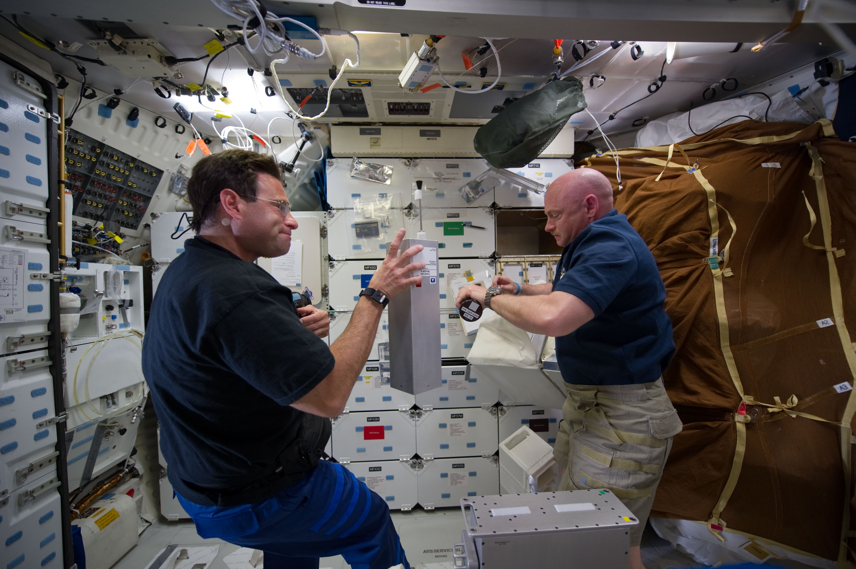
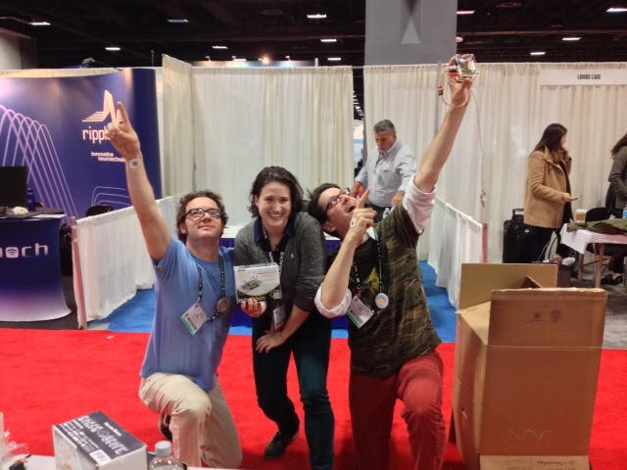
NanoRacks’ Role
Payload integration company
Safety and Integration Requirements
Manifesting
Operations Planning Products and Procedures
Functional Testing
Payload delivery to NASA for launch
On-Orbit Operations
Return of the payload to Earth

Slide 3
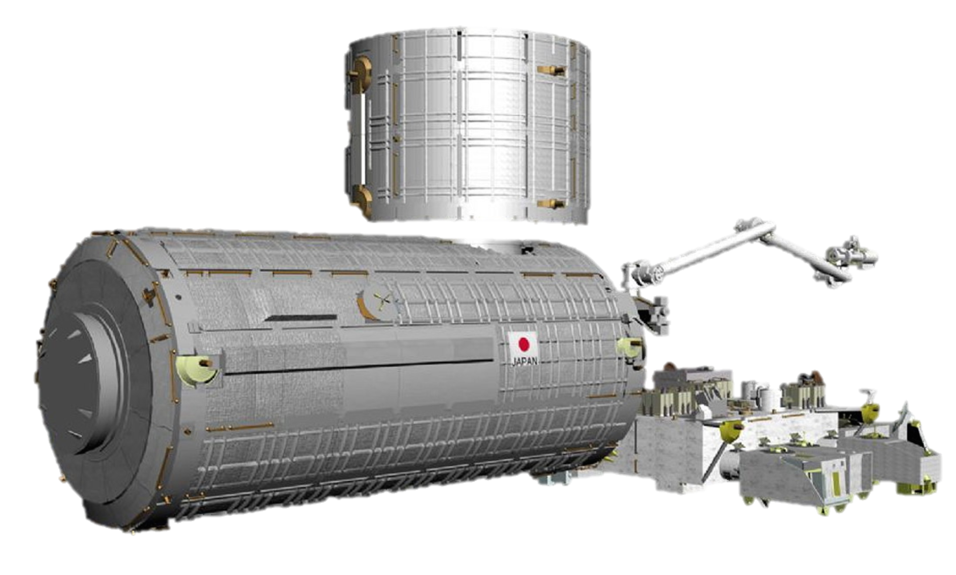
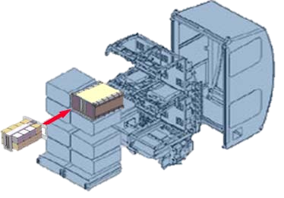

Slide 4
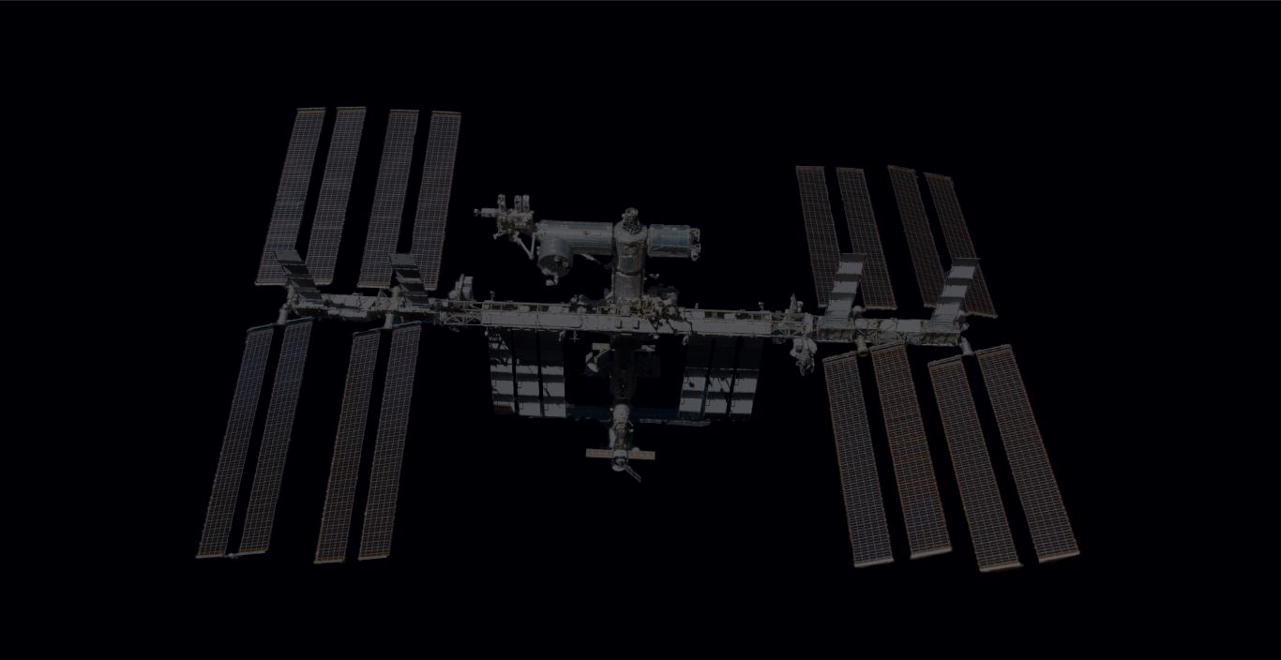
Safety Inputs (L-5.5 Months) Operational Inputs (L-5.5 to 3.5 Months)
Safety and Manifesting Inputs
All information as documented in the safety data template needs to be provided
All design aspects need to be covered. This includes, but is not limited to: bill of materials (and how much of it), parts list, and how exactly these all fit together (the types of fasteners or glue, etc.)
Provide electrical diagrams and labeled CAD drawings and anything else to help us understand your payload
Safety schedule based on an April launch:
Initial documentation submittal to NanoRacks
NanoRacks submittal to NASA
Phase I/II Safety Review with NASA
Second documentation submittal to NanoRacks
NanoRacks Submittal to NASA
Phase III Safety Review with NASA
Operation inputs
Installation and cold stow requirements
Timelines for planning (use an exact date and ranges)
Payload handling requirements
The earlier you provide safety and operational inputs, the better we can guide you through the NASA safety process.
Late inputs and any changes to hardware after Phase III information is submitted will impact the schedule – possible missed flight

Slide 5
Safety Inputs (L-5.5 Months) Operational Inputs (L-5.5 to 3.5 Months)
Main areas of concern for Safety
Batteries/capacitors
Materials/toxicity/biologicals
Chemicals/liquids/gasses/powders/greases
Biologicals – must be purchased from a qualified supplier
No contamination, pesticides, it is what it is – Vendor CoC
Nonmetallics/glues/adhesives/sealants/greases/plastics
Metallics
Compatibility (may have to perform compatibility test)
Levels of containment
Verify each level independently
Configuration/design (CAD/Solidworks, drawings, schematics)
EMI
Cable vs. no Cable
Inside rack vs. outside rack
Plastic case vs. aluminum case
Rotating Equipment (fans, motors)
Magnets
Fasteners – secondary locking features
Shatterable materials
Workmanship – staking, wire restraint, sharp edges
Electrical
High voltage sources
Maximum voltage/current
Wire size, circuit protection
Batteries/capacitors
Acceptance and qualification testing may be required
Grounding/bonding
Crew operations/crew time

Slide 6
Functionality Testing (No later than 3.5 months)
Fit
Dimensional properties
Physical connection between the NanoRacks Platforms and your payload
Form
Inspecting payloads to verify design for safety purposes
Inspecting for structural integrity
Function
Software interface between the NanoRacks Platform and your payload
Ground testing to ensure proper functionality on-orbit

Slide 7
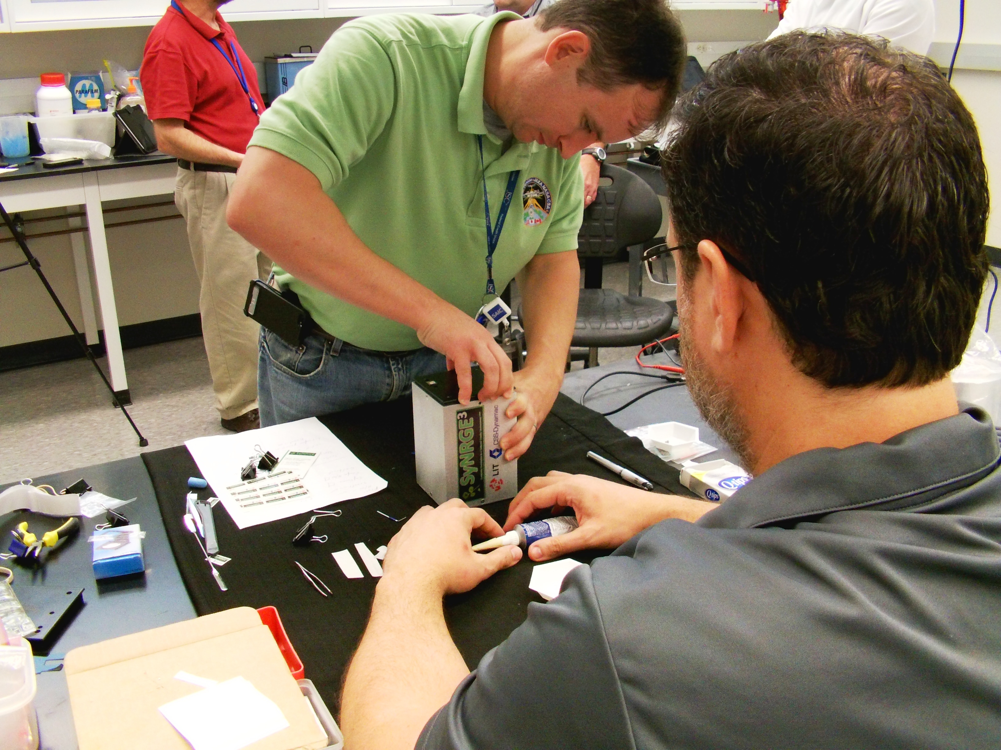
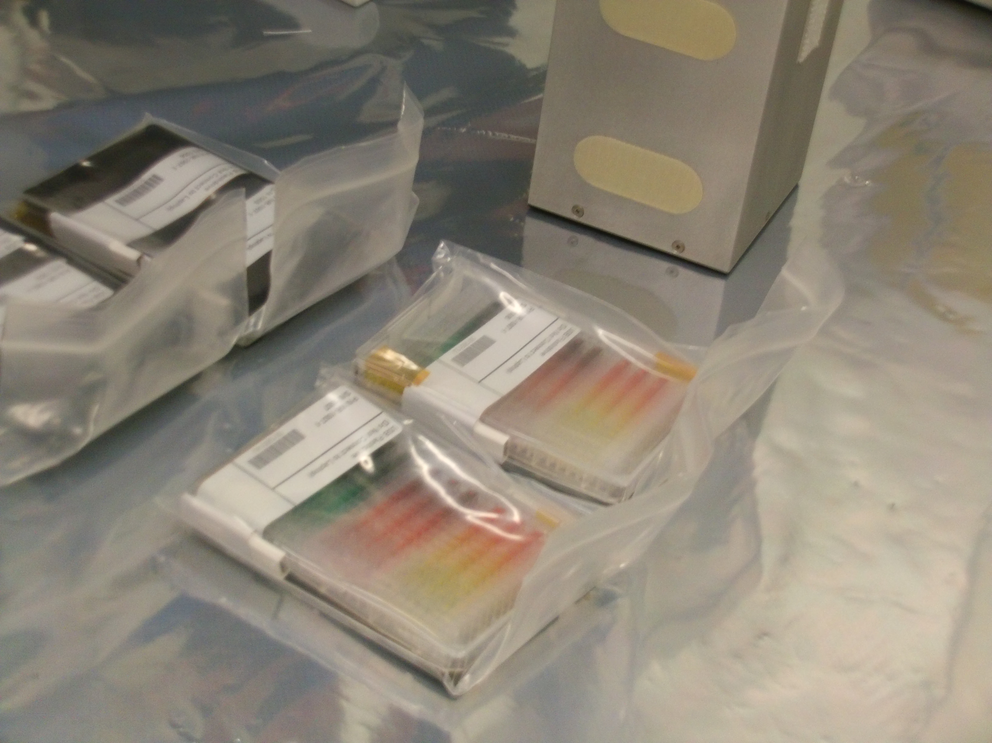
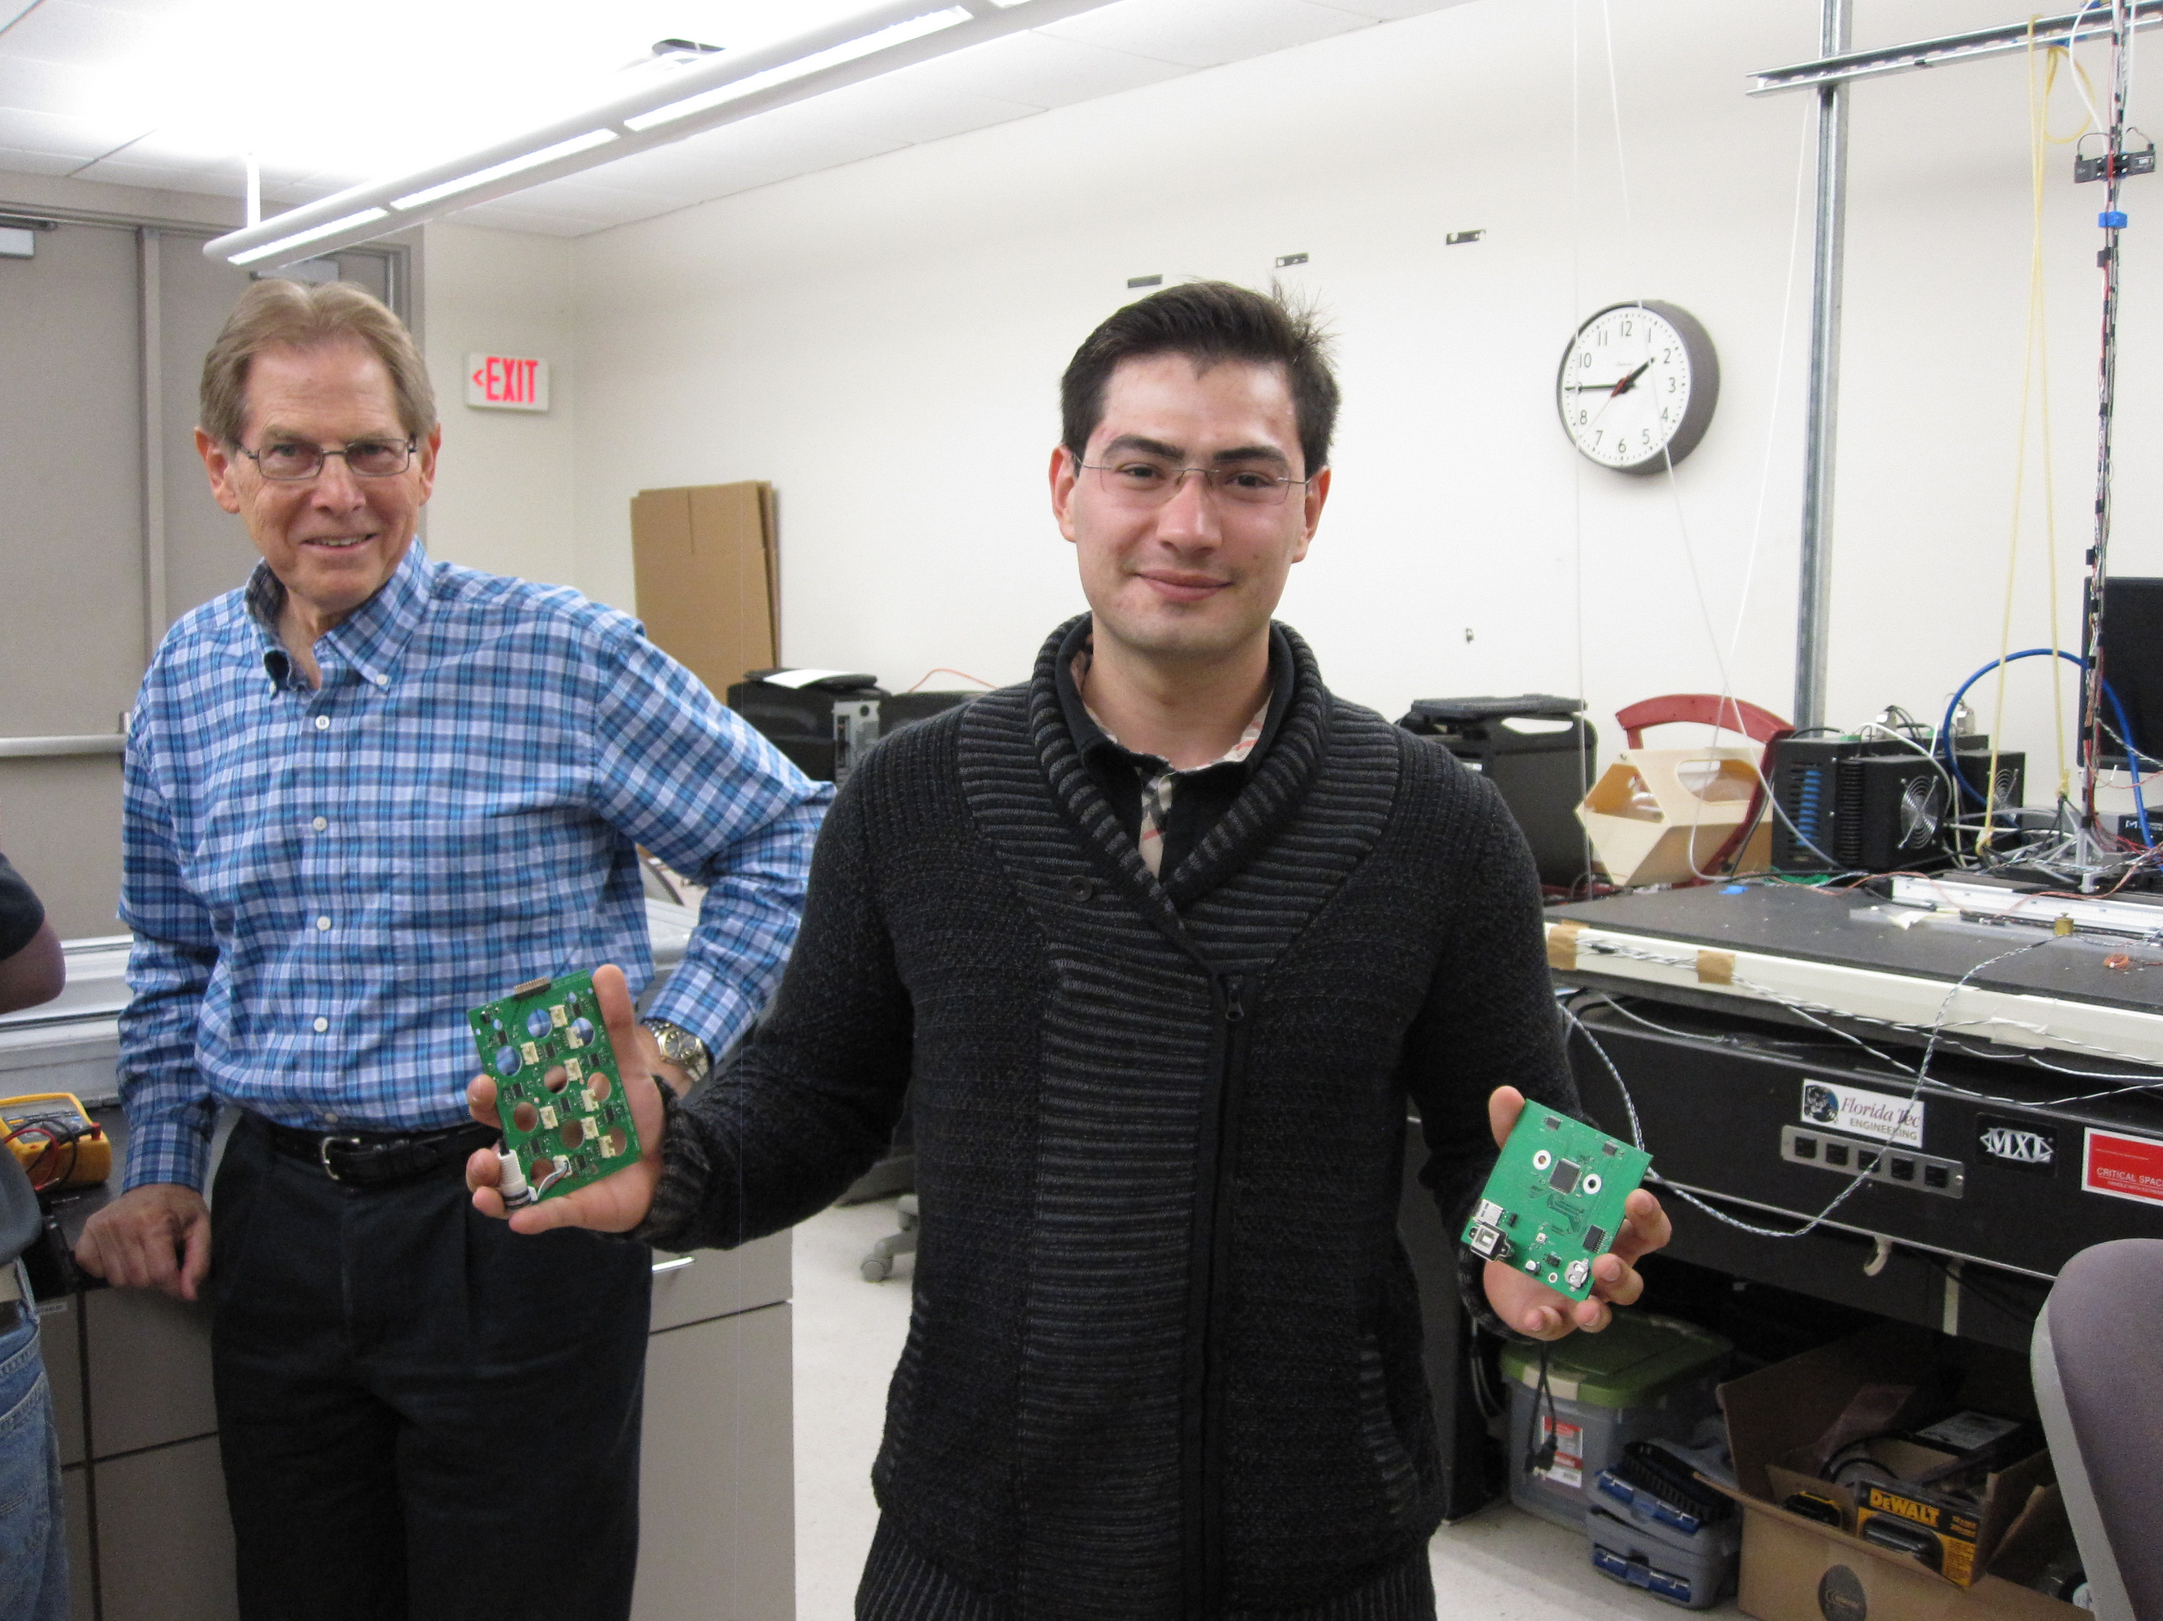
Functionality Testing (No later than 3.5 months)
Since NanoRacks will be thoroughly inspecting your NanoLab (inside and out, as well as code), please provide instructions on how to disassembly your payload, your code, and special handling requirements
Your science should NOT be loaded into the NanoLab at this time (this is only a hardware and software test).

Slide 8
Handover from NanoRacks to NASA
Handover from you to NanoRacks will take place anywhere from L-45 days to no later than L-32 hours.
HFIT
Astronaut handling
Handover timeline
Launches rarely go as planned
48-hour scrub scenario with a 2 hours refresh period.
While your payload may be handed over a few hours from launch, there is a high probability your payload will not be installed until days later (most payloads are not installed until at least 5 days after handover to NASA).

Slide 9
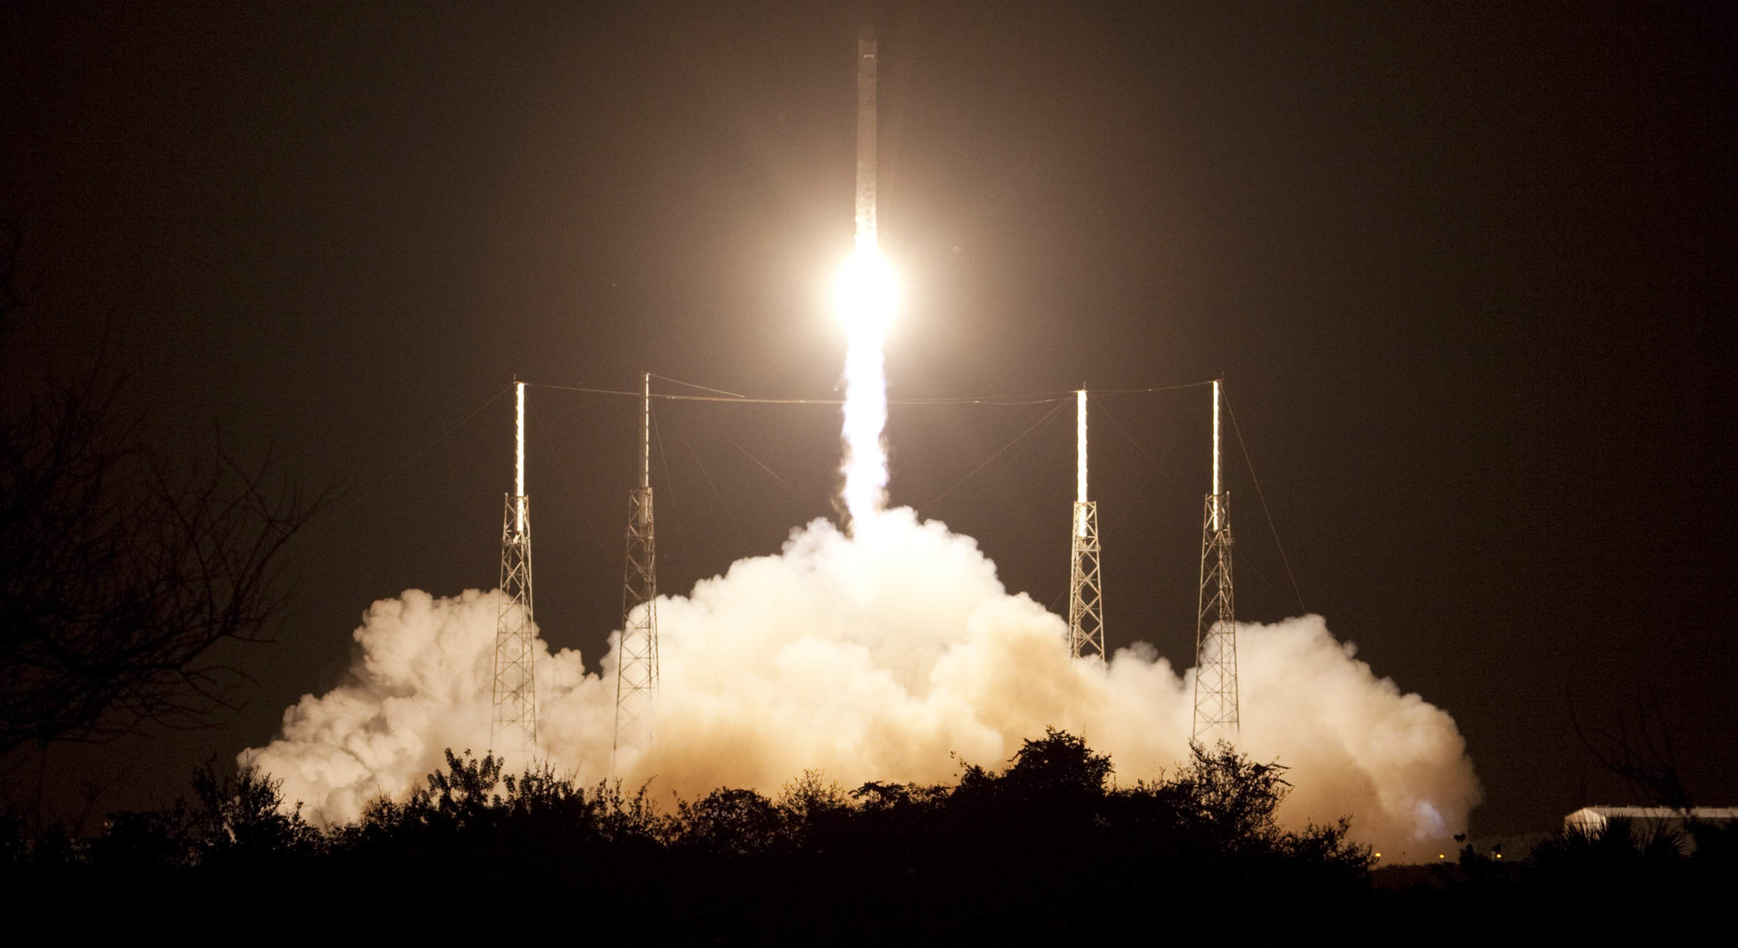

Slide 10
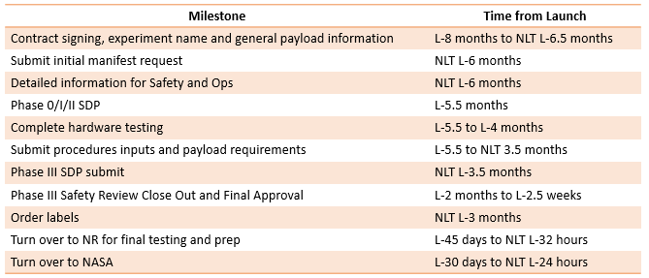

Slide 11
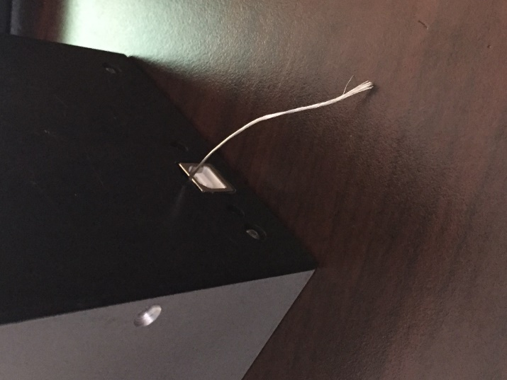
NanoLabs Lessons Learned
USB Ports
USB ports need to be recessed to be flush with the outer surface of the module
Solder a 3 inch small gauge wire to the outside casing of the USB port. This wire will be used by NanoRacks to ground the payload before handover to NASA. Soldered wires are expected to pass a tug test.
Exterior of the NanoLab
For crew safety concerns, nothing should be sticking out of exterior housing of the NanoLab.

Slide 12
NanoLabs Lessons Learned
Accessibility
The NanoLab is small, which can make it difficult space to work in. Keep accessibility in mind when designing your payload so that it will be easier to work with throughout the manufacturing and testing process.
Screws instead of glue
Environmental Awareness
Your payload will be sharing the space with other payloads and astronauts. Design your payload so that there is a minimal impact on its surrounding environment.

Slide 13
NanoLabs Lessons Learned
Fasteners
Size 4-40 countersunk screws for the exterior of your NanoLab
Size 4-40 button head or pan head screws for the interior of your NanoLab
Consider using allen wrenches instead of cross-tip screwdrivers
Communication
NanoRacks, CASIS, Texas A&M, and your mentors are here to help. If you have any questions, please don’t be afraid to ask us. The earlier we know of the situation, the sooner we can come up with a solution that fits all safety, integration, operational, and payload customer needs requirements.

Slide 14
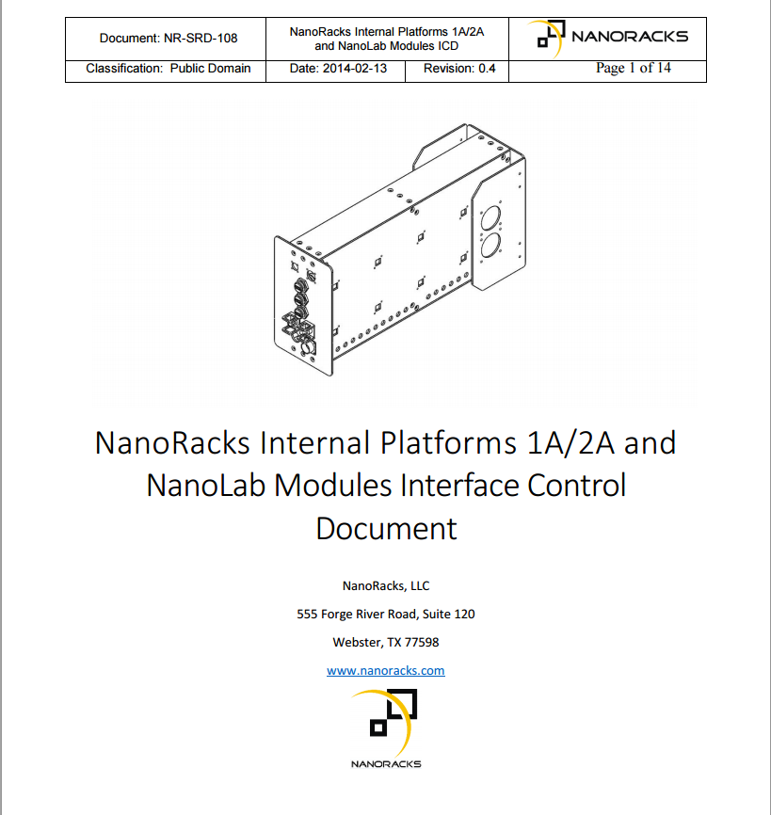
NanoLabs Interface Control Document
For a more through guide to payload requirements concerning NanoLabs, you can refer to the NanoLabs Interface Control Document on the NanoRacks website: NanoRacks.com

Slide 15
Questions?
Mariel Rico
Payload Integration Engineer
mrico@nanoracks.com

