Slide 1
CASIS NATIONAL DESIGN CHALLENGE PHASE II KICKOFF MEETING
GOVERNMENT
INDUSTRY
ESET/MISL/PIC
OVERVIEW
Dr. Joseph A. Morgan, P.E.
Professor, Texas A&M University
May 8-9, 2014
ACADEMIA

Slide 2
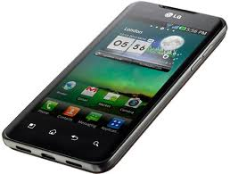
ESET Program
Focus on electronic products and systems
Experiential learning based
Curriculum consists of three technical tracks with integrated systems level courses
Culminating in real-world experience
Capstone Design Project
Two semester sequence
Instrumentation and Controls
Testing
Quality
Product Development
Experiential Capstone
Analog/Digital Electronics
Embedded Systems
Communications
Products and Systems

Slide 3
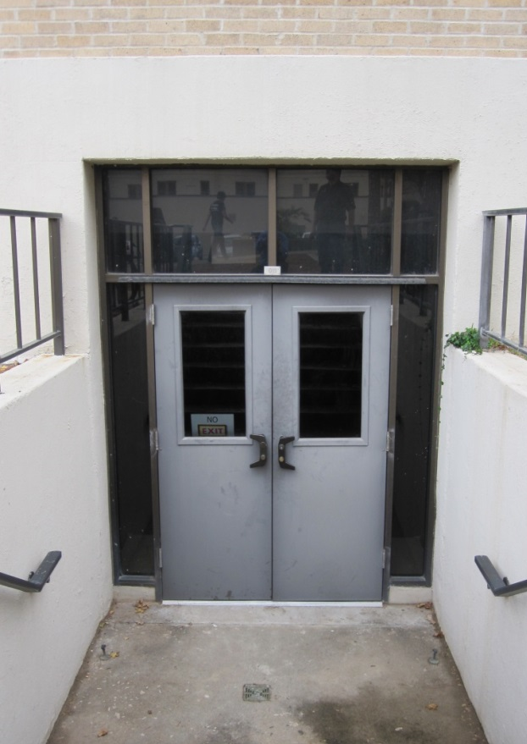
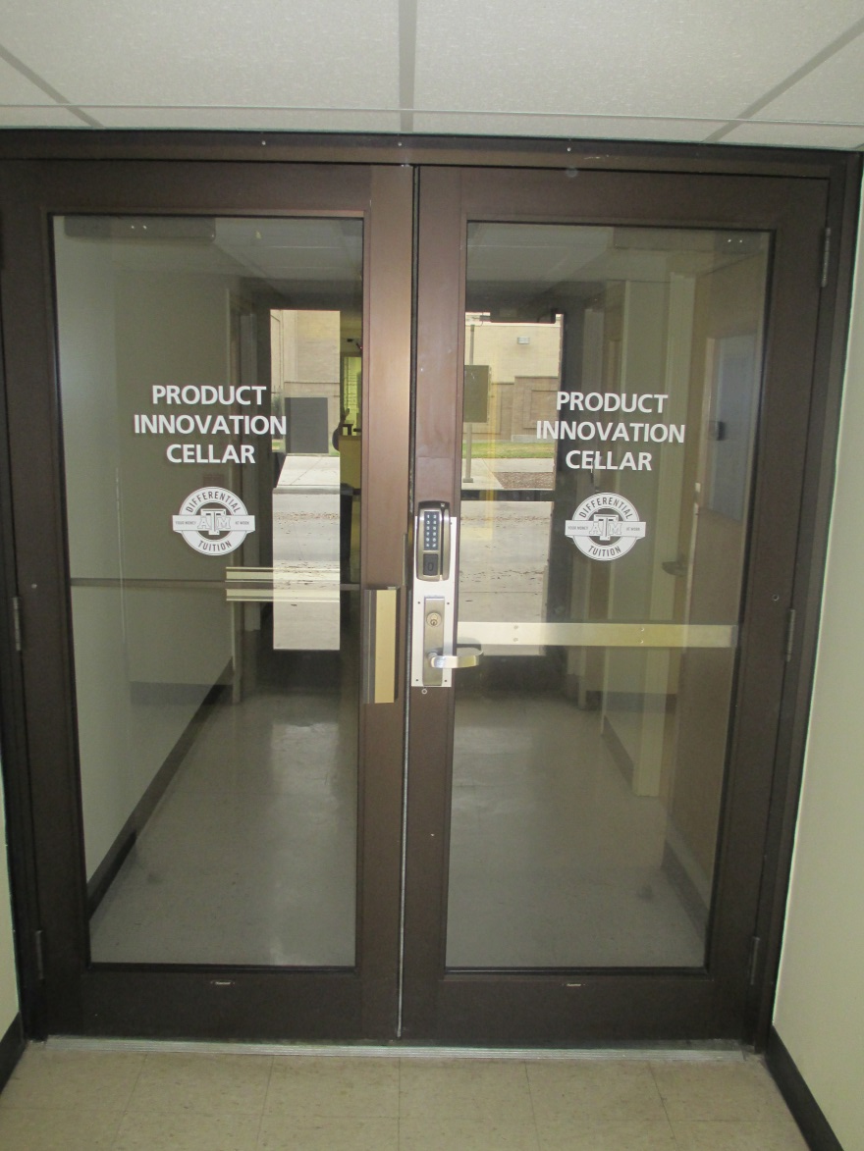
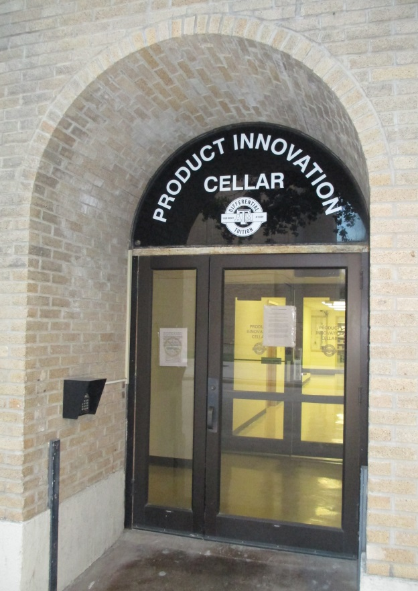
Mobile Integrated Solutions Laboratory/ Product Innovation Cellar
Support and Encourage
Innovation
Multidisciplinary Activities
Entrepreneurship
Commercialization
Facility
3400 ft² facility
Opened – Feb 2013
5 functional areas
3 support areas
Unique Features
24/7 operation
Student operated
PRODUCT INNOVATION CELLAR

Slide 4
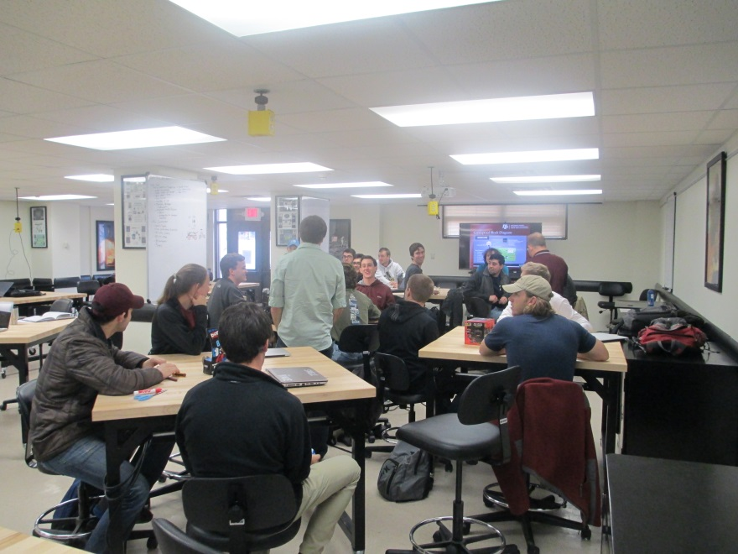
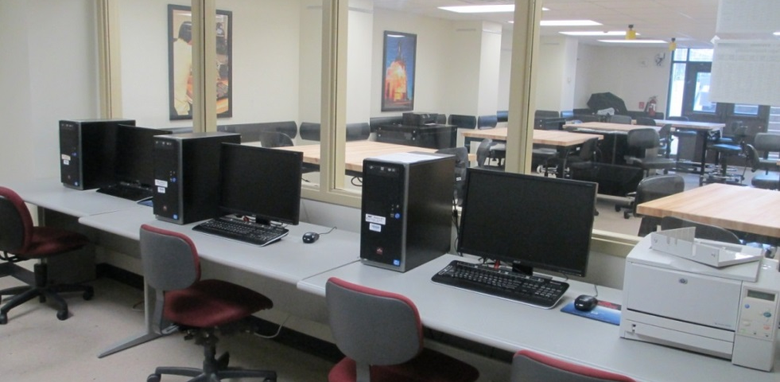
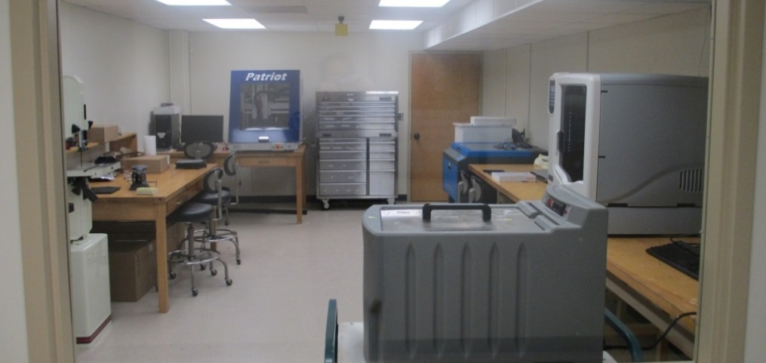
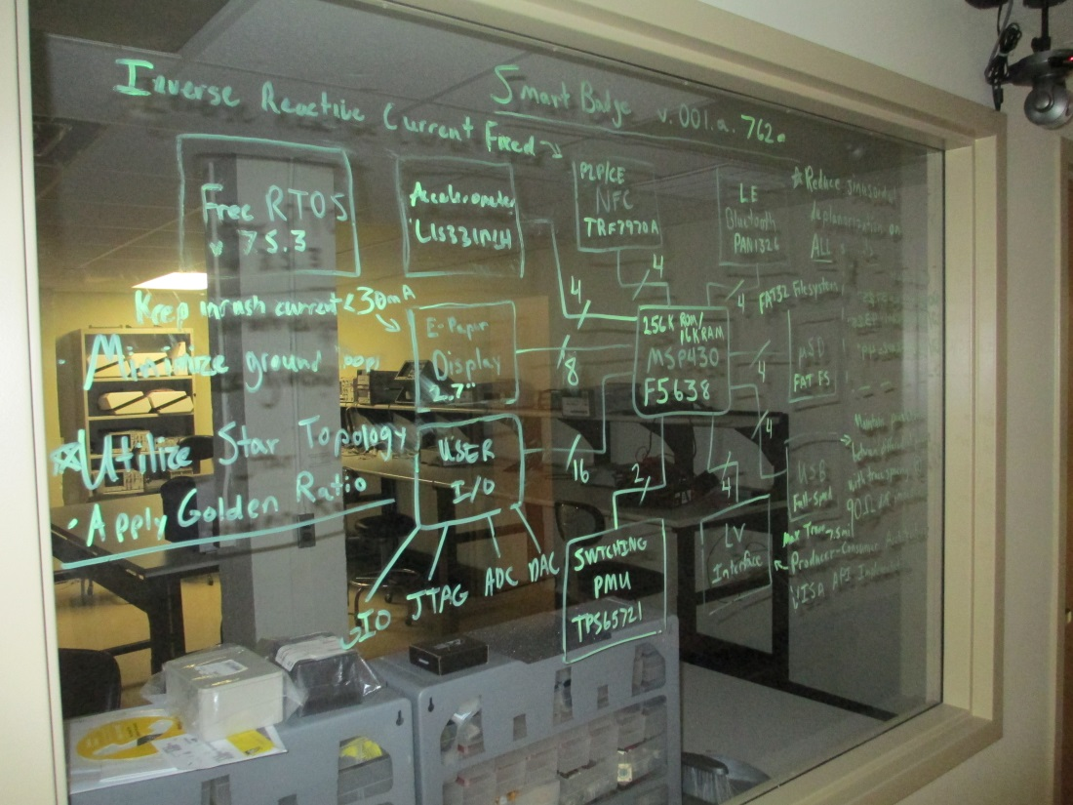
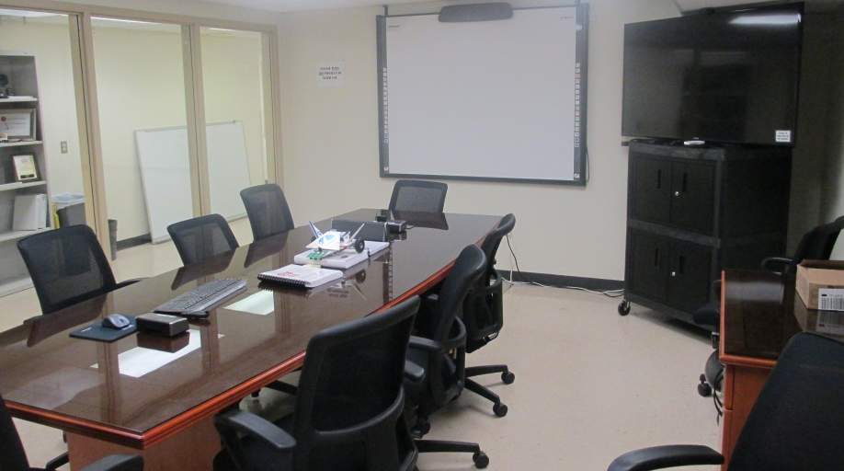
MISL/PIC
Development Area
Design Suite
Mechanical Fab
Electronics Fab
Collaboration Room
STEM PROJECTS
Krisys Robotics
NESI
Extreme Science
NDC
Zero Robotics
100kFt Rocket Payload

Slide 5
What MISL/PIC brings to the table
Embedded systems development expertise
Electronics Software
Test & Validation Documentation
STEM interest
Outreach Recruiting
Motivation Education
NDC experience
Resources
Physical Personnel
Industry Partnerships

Slide 6
Educational Approach
Educate using the real stuff
Video tutorials
Record screen
Record voice
Watch how to do it – not read how to do it
Share knowledge
Mentors with teams
Teams with teams
Recommend student leaders
Hardware Engineer
Software Engineer

Slide 7
Teacher Workshop -- NESI
Dates – July 2x – 2y
Format
3 days
Hands on
Interaction
Introduction
Enclosure
NESI Board and peripherals
Example project
Process
Hardware development
Sensors and Actuators Interfacing -- Sparkfun
Software development
Integration
Testing

Slide 8
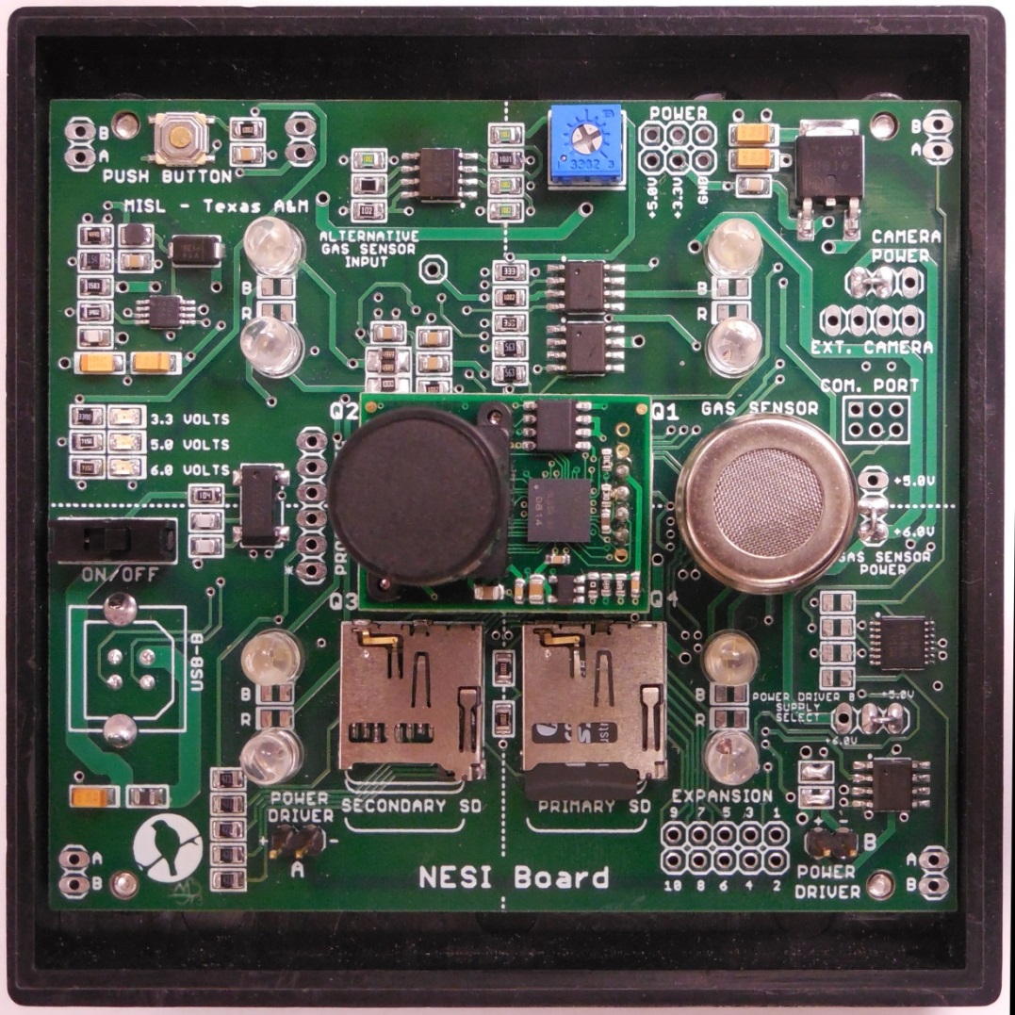
NESI Board in NanoRacks Endcap
Features:
Space Qualified by NanoRacks
Designed specifically for 1U and 1.5U enclosures
Common elements on board
3.75”
Upgrades for Phase II:
New interfaces (I2C)
Common connectors
More control

Slide 9
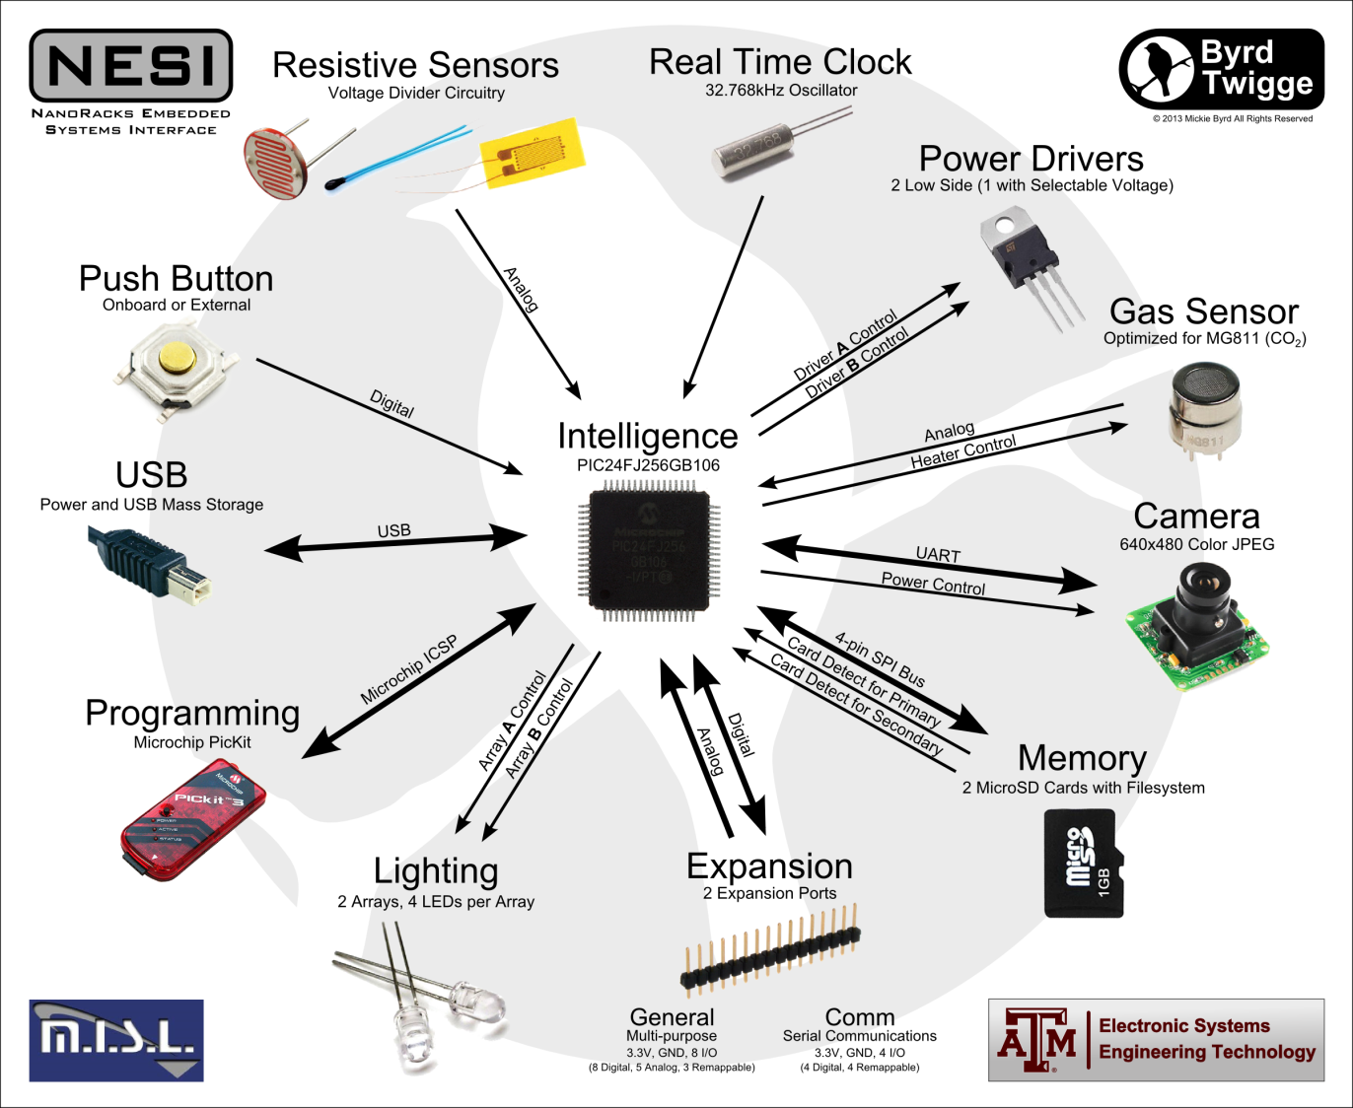
NESI Board Functionality

Slide 10
Example - Camera
On Board Camera Mount
Secondary Header
3.3V
JP7
JP13
PIC24
1
1
TX
RP26
5
2
2
RX
RP19
6
3
3
4
4
PIC24
IC1
Camera
Enable
Low
Side
Power
Driver
JP15
DO E1
61
4
5/6
1
3
2
3
Camera Power Control Header

Slide 11
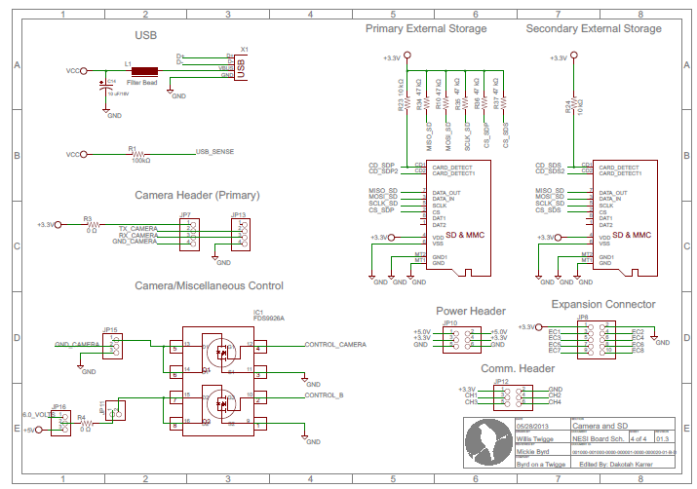
Schematic

Slide 12
On the Board
Grd Select
External camera interface - ON
Internal camera interface -- Grd selectable

Slide 13
Recipe For Success
A step-by-step guide for the successful Integration of
NESI Board
into
NDC Experiment

Slide 14
Embedded Systems
Electronic Hardware
Students take ownership of NESI Board
Configure
Solder components
Design
Conceptual
Functional
Software
Storyboard
C Programming Language
Modify/integrate code modules
Test and Validate
Proven process that works
Pantry (wiki) – all resources available
Recipe – step-by-step approach to effective communications and success

Slide 15
Functional Diagram

Slide 16
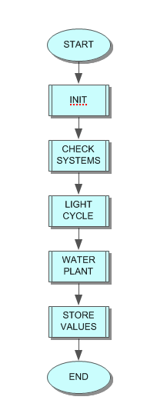
Main
The main method of the
microcontroller will water the
plants, store the values, and
take the pictures.

Slide 17
Systems Check
The system checks all sensors to make sure that sufficient power is reaching all of the sensors that we need.

Slide 18
Check-off List
Hardware Engineer | Software Engineer | All Team Members
Hardware Overview | - | -
Soldering Videos | - | -
Soldering NESI Board | - | -
- | Download MPLAB X | -
- | Software Environment Test | -
- | Download/Unzip Code | -
- | NESI Software | -
- | - | Hardware Integration
- | - | Create Storyboard
- | - | Determine Peripherals
- | - | Create FBD
- | - | Start Experiment

Slide 19
HARDWARE

Slide 20
Watch Hardware Overview
The first step for the hardware engineer is to watch the NESI Hardware Overview video
The NESI Hardware Overview video can be accessed using the following link: https://www.youtube.com/watch?v=ydAVm43RE8g
The NESI Board Schematic can be found at: http://nesiwiki.tamu.edu/images/5/54/NESI_Schematic1.3.pdf

Slide 21
SOFTWARE

Slide 22
Download MPLAB X
The first step of the software engineer is to download MPLAB X and the XC16 compiler from microchip.com
Video that details process can be found at : https://www.youtube.com/watch?v=vo1ejavY84o
Microchip website for download: https://www.microchip.com/pagehandler/en-us/family/mplabx/
Notes: Make sure to download latest versions

Slide 23
ALL

Slide 24
Watch Hardware Integration
Watch the Example Project: Hardware Integration video
The video walks step-by-step from a problem statement to a completed hardware set
The Hardware Integration video can be accessed using the following link: https://www.youtube.com/watch?v=rJpJuohw0ss
Note: This step is to be completed by all members of the team

Slide 25
NDC Project Development Timeline
Project Timeline
Hardware Activities
Software Activities
Management Activities

Slide 26
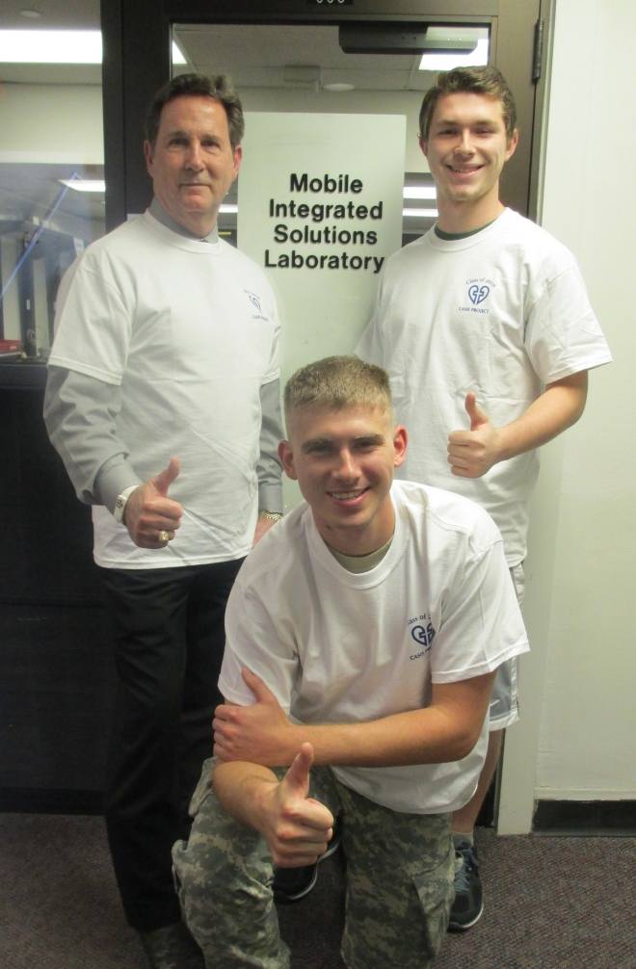
Support
Mentor Team
J. Morgan, D. Karrer, C. Shumank
One undergrad student per team
NDCwiki.tamu.edu
On-line support
Restricted development community
Zoom Video Conferences
Brainstorming
Problem solving
Scheduled (mentor and team)
Industry Partnerships
Sparkfun
Microchip
NanoRacks
Others

Slide 27
Required Resources
Soldering iron
Development computer
High speed internet access
Zoom audio/video capability
Sensors
Actuators
Data Card(s)
Experiment materials

Slide 28
GOVERNMENT
INDUSTRY
ACADEMIA

